Slide 1
Nuclear Energy
Evan Honeysett
Notes:
When most people think of the word nuclear, the first thought that comes to many of our minds are mushroom clouds and nuclear fallout.
However, the prospects of alternative energy sources are becoming more viable as the world seeks to phase out fossil fuels. As a result, attentioned has turned to the prospects of nuclear energy.
Nuclear energy is a complex and evolving technological pursuit that seeks to ensure safety and efficiency by using cutting edge technology.
In order to understand nuclear energy we know today, it is important to understand its history. So, we will be walking through three important aspects of its lifecycle: the original discovery, how it looks today, and its implications for the future of energy.

Slide 2
History of Nuclear Energy

Slide 3
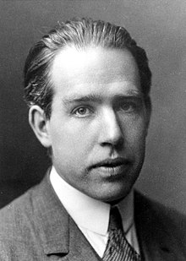
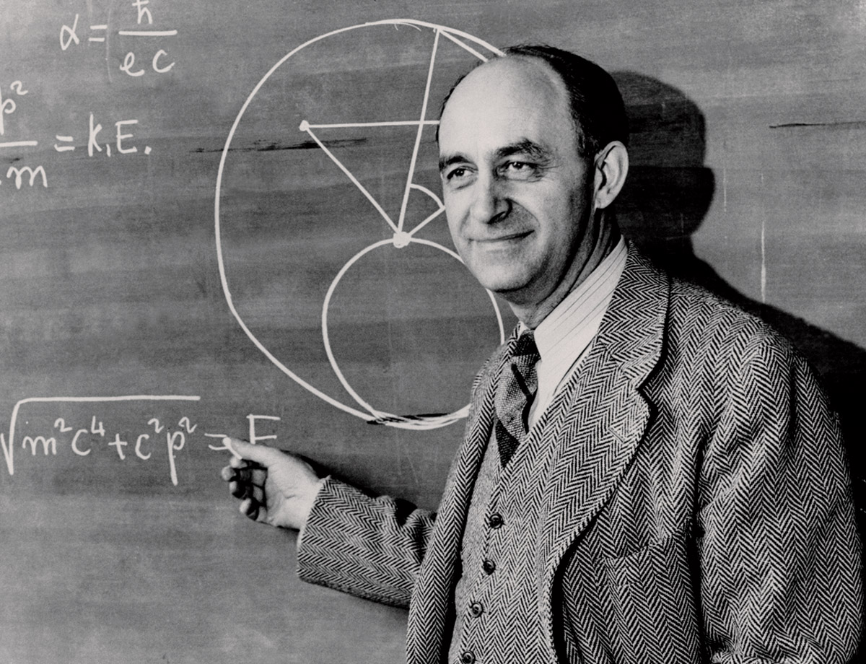
In 1939, physicists such as Bohr and Fermi conducted experiments on isotopes such as Uranium 235.
Niels Bohr
Enrico Fermi
Notes:
Ever since Uranium was discovered in 1789, our perception of atoms and their form has shifted.
However, the most important breakthrough for the viability of nuclear energy came in 1939, when scientists such as Niels Bohr and Enrico Fermi eagerly researched isotopes like Uranium 235 and 238.
[History] U.S. Department of Energy. (2011) → Bohr met Fermi at a conference on theoretical physics in Washington, D.C. They discussed the exciting possibility of a self-sustaining chain reaction. In such a process, atoms could be split to release large amounts of energy.
This concept became known as nuclear fission. Now, let us break down how nuclear fission works.

Slide 4
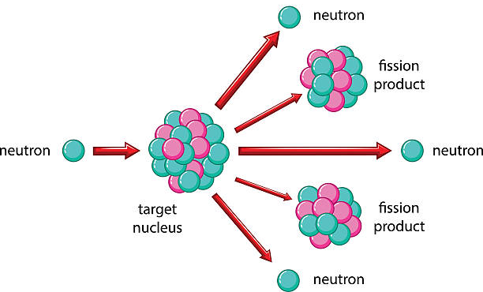
Nuclear fission occurs when a heavy nucleus splits upon impact with another particle.
Source
Notes:
Nuclear fission occurs when a heavy nucleus splits spontaneously or on impact with another particle, with the release of energy.
So in their experiments, Bohr and Fermi studied the viability of hitting the target nuclear (Uranium 235/238) with a free neutron, and then studying its effects.
When the nucleus is hit, there are three important results.
Fission product
The combined mass of the fission products is less than that of the original U-235.
Energy
The reduction occurs because some of the matter changes into energy.
Neutron
This could also cause a chain reaction, leading to a possibly self sustaining cycle with enormous energy release.

Slide 5
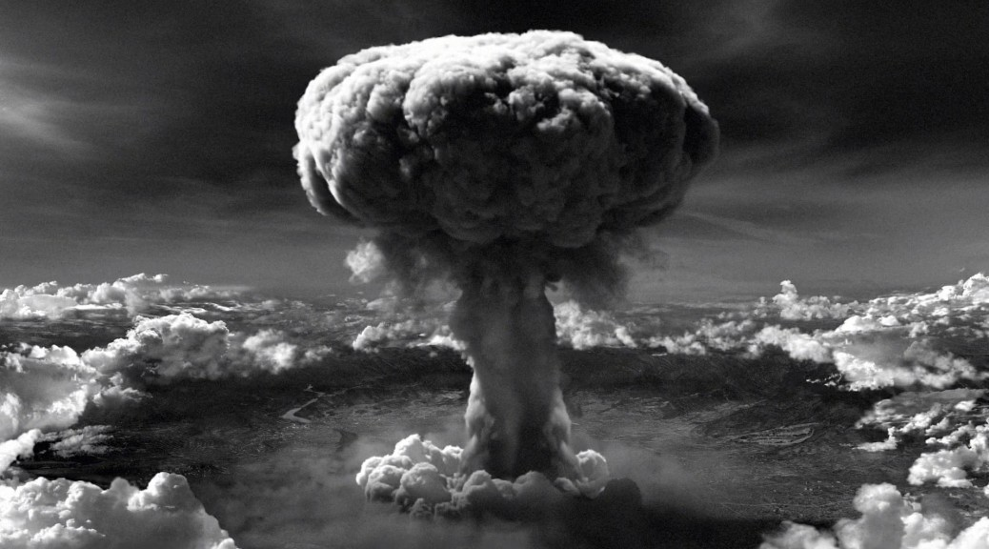
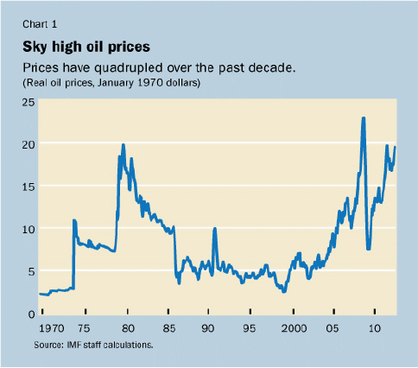
Many factors such as the development of the atomic bomb and oil prices have influenced nuclear energy.
Source
Source
Notes:
While we could call this the birth of nuclear energy, many things have influenced its implementation.
Due to the timing of the discovery, there is no surprise that some of the early research was done to determine how this energy could be powered into a weapon.
The first atomic device tested successfully at Alamagordo in New Mexico on 16 July 1945.
In the course of developing nuclear weapons the Soviet Union and the West had acquired a range of new technologies and scientists realised that the tremendous heat produced in the process could be tapped either for direct use or for generating electricity.
Transition: 1970s → Oil prices skyrocketed, thus the need for cheaper energy.

Slide 6
Nuclear Energy Today

Slide 7

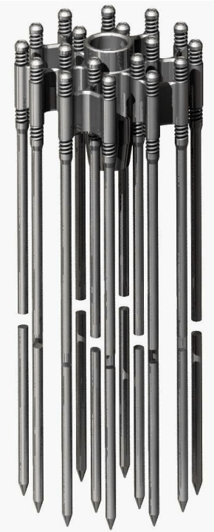
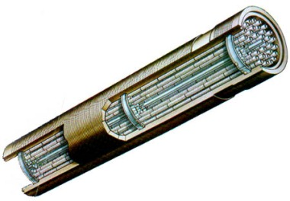
Nuclear fission reactors have three key components: fuel elements, control rods, and a moderator.
Fuel Elements
Moderator
Control Rod
Notes:
3 crucial components
Fuel elements
thin rods with fissionable nuclei such as Uranium 235/238. They vary based on the size of the reactor (region is called the reactor core).
Moderator
Slow down the energy neutrons in the nuclear reactor, which is produced in the nuclear fission process as we had discussed before. Using water is convenient since it is accessible and used elsewhere in the process anyway.
Control Rod
allow for a steady output of energy, ensure there are spare neutrons available to create nuclear fission, and this controlled. They absorb neutrons to prevent fission. They can be added/removed to slow down or speed up.

Slide 8
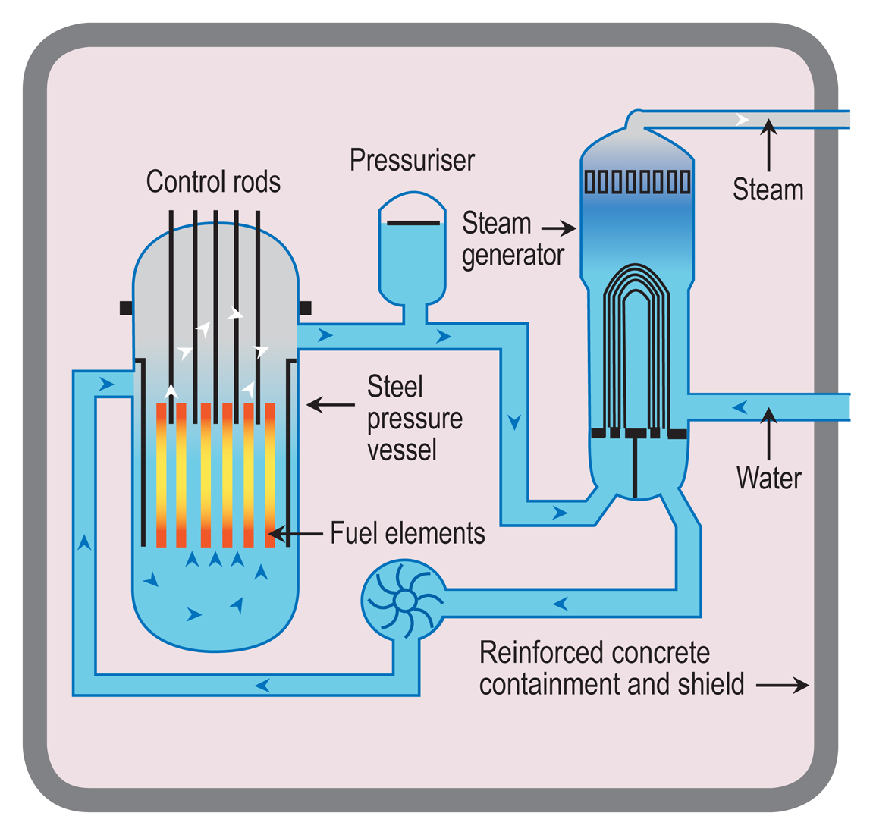
Nuclear energy is a result of the interaction between these components in a complex system.
Source
Notes:
Nuclear reactors today are closely controlled chain reaction, which is the opposite of the fast and chaotic reaction of the atomic bomb.
[Today] Energy Information Administration. → The reactor core has essentially no moving parts except for a small number of control rods that are inserted to regulate the nuclear fission reaction. Placing the fuel assemblies next to each other and adding water initiates the nuclear reaction.
Due to the high amount of heat created in the process, the water in the heat exchanger is turned to steam, which in turn powers the turbines which produce energy. Water is put in/out using the pump.
[Today] Zinkle, S., & Was, G. (2013). → Nuclear power currently provides about 13% of electrical power worldwide, and has emerged as a reliable baseload source of electricity

Slide 9
Future of Nuclear Energy
Notes:
As the world looks for alternatives to move away from fossil fuels, the topic often turns to nuclear energy. So, let's take a look into the future to see what advances can be made in nuclear energy (as well as the challenges).

Slide 10
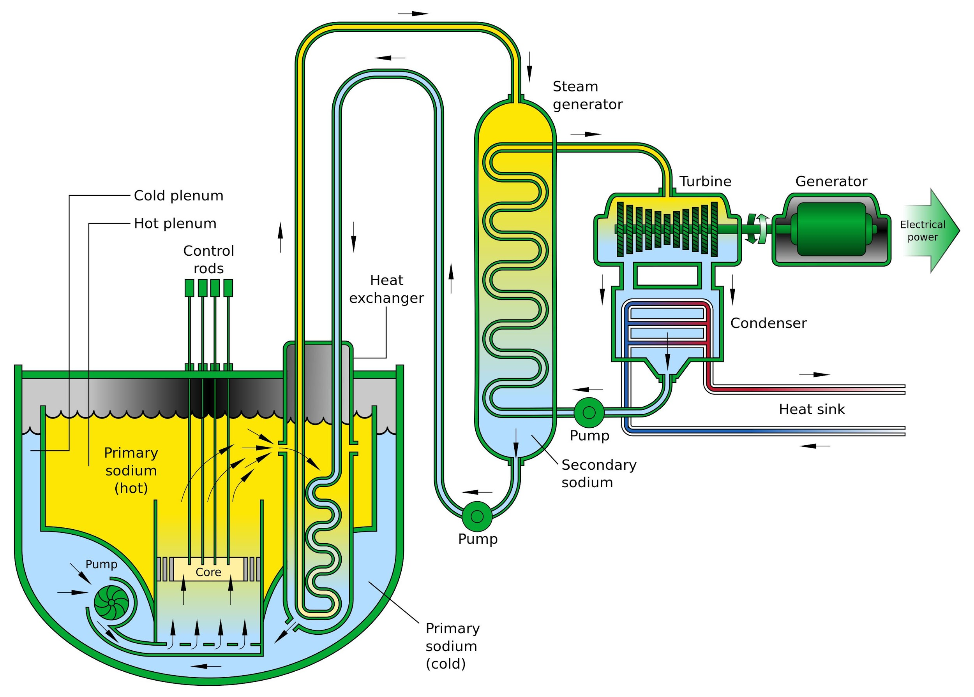
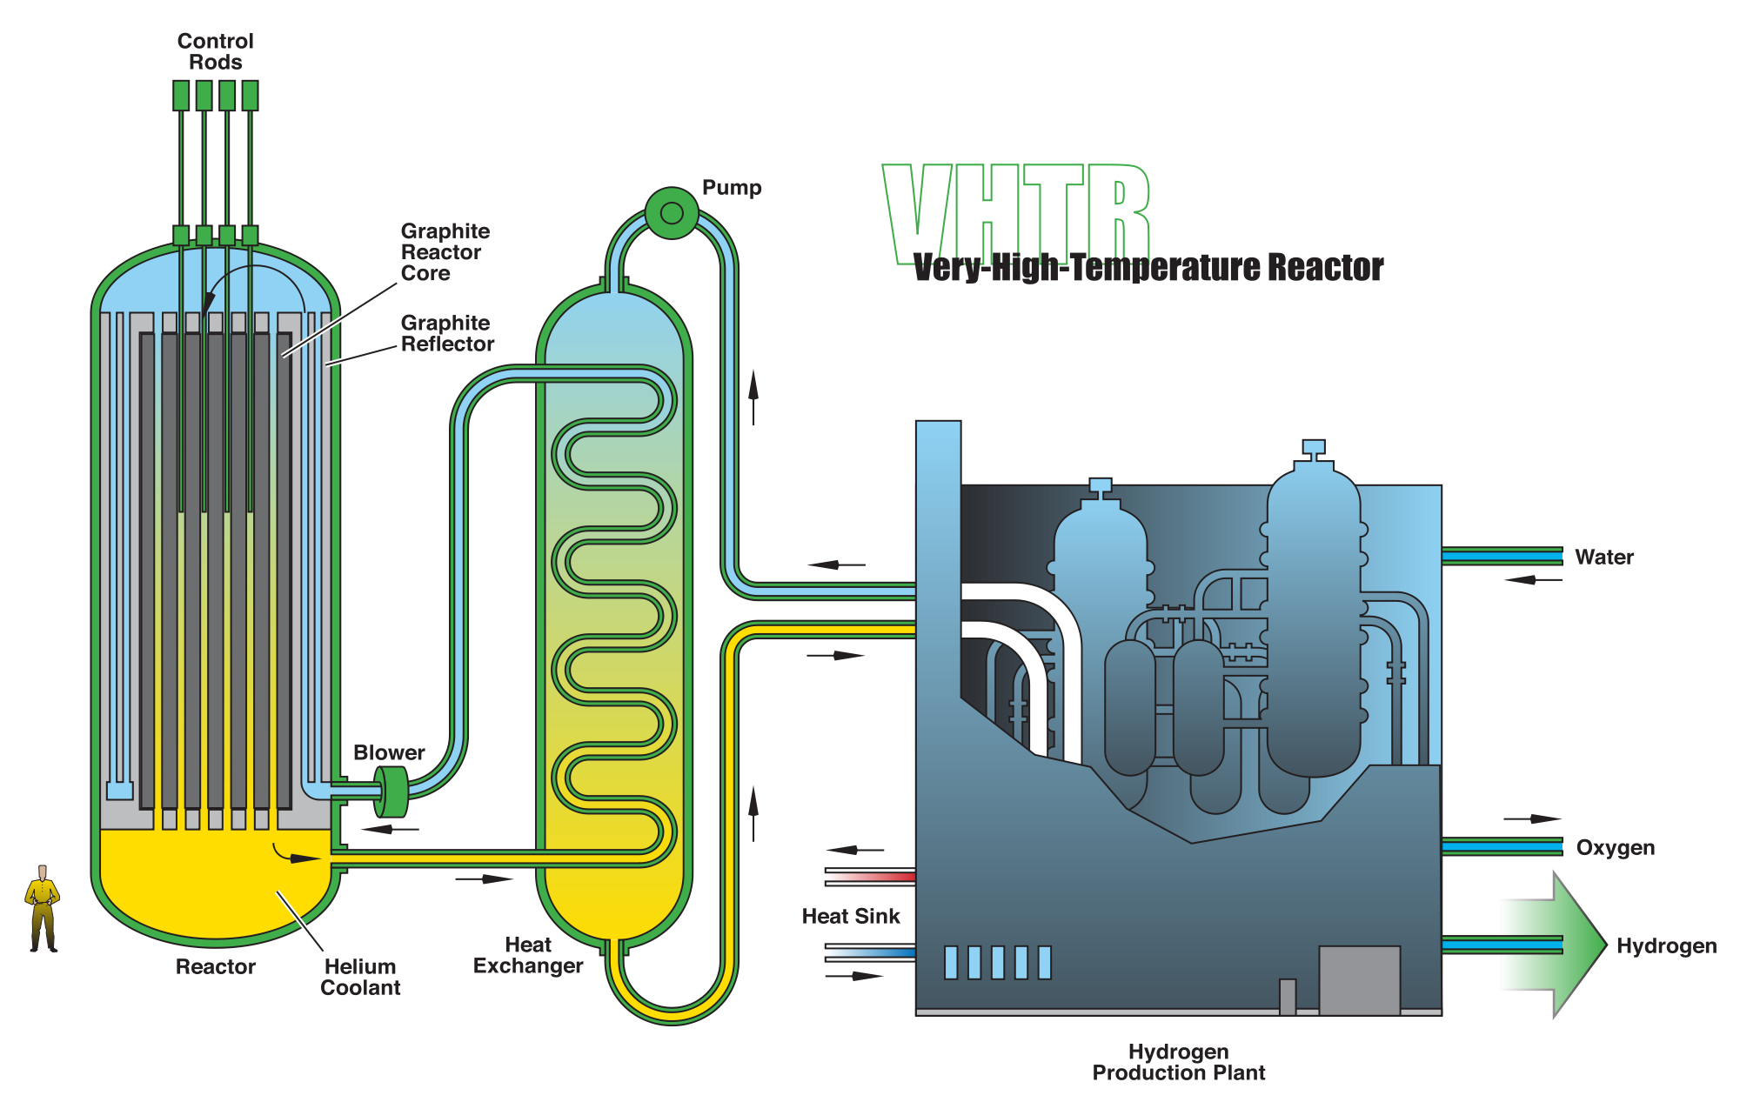
New and innovative reactors, called Generation IV, are being tested for future use → the two types are Thermal and Fast.
VHTR
SFR
Notes:
Some of the most innovative designs for nuclear reactors are called “Generation IV reactors”.
[Future] Gen IV International Forum → Generation IV designs will use fuel more efficiently, reduce waste production, be economically competitive, and meet stringent standards of safety and proliferation resistance.
This forum has set a goal of 2030 for deployment, and there are two main kinds.
Thermal reactors
A thermal reactor is a nuclear reactor that uses slow or thermal neutrons. A neutron moderator is used to slow the neutrons emitted by fission to make them more likely to be captured by the fuel (like the one explained earlier).
VHTR → The very high temperature reactor concept uses a graphite-moderated core with a once-through uranium fuel cycle, using helium or molten salt as the coolant. This reactor design envisions an outlet temperature of 1,000 °C
Fast reactors
A fast reactor directly uses the fast neutrons emitted by fission, without moderation.
SFR → The SFR reactor concept is cooled by liquid sodium and fueled by a metallic alloy of uranium and plutonium or spent nuclear fuel.
However, there are many problems that can arise when designing and implementing these designs.
[Future] Murty, K., & Charit, I. (2008) → The structural materials need to endure much higher temperatures, higher neutron doses and extremely corrosive environment, which are beyond the experience of the current nuclear power plants.
Safety & public concern

Slide 11
What will the future of Nuclear Energy hold?
Notes:
In conclusion, nuclear energy is the result of reactions in a complex system that is only getter more efficient and safe as technology advances.
During this presentation, we walked through three important aspects of its lifecycle: the original discovery, how it looks today, and its implications for the future of energy.
Hopefully sometime in the future, our perception will shift from nuclear fallout to a viable and sustainable energy option. Thank you.

